Slide 1
Lock-In Amplifier
Desktop (LabView Interface)
Channel A
Reference Channel
Resistor or Terminator
Function Generator

Slide 2
Lock-In Amplifier
Desktop (LabView Interface)
Channel A and Channel B
Reference Channel
Resistor or Terminator
Function Generator

Slide 3
Lock-In Amplifier
Desktop (LabView Interface)
Channel A
Reference Channel
Cryostat with Resistor Inside
Function Generator

Slide 4
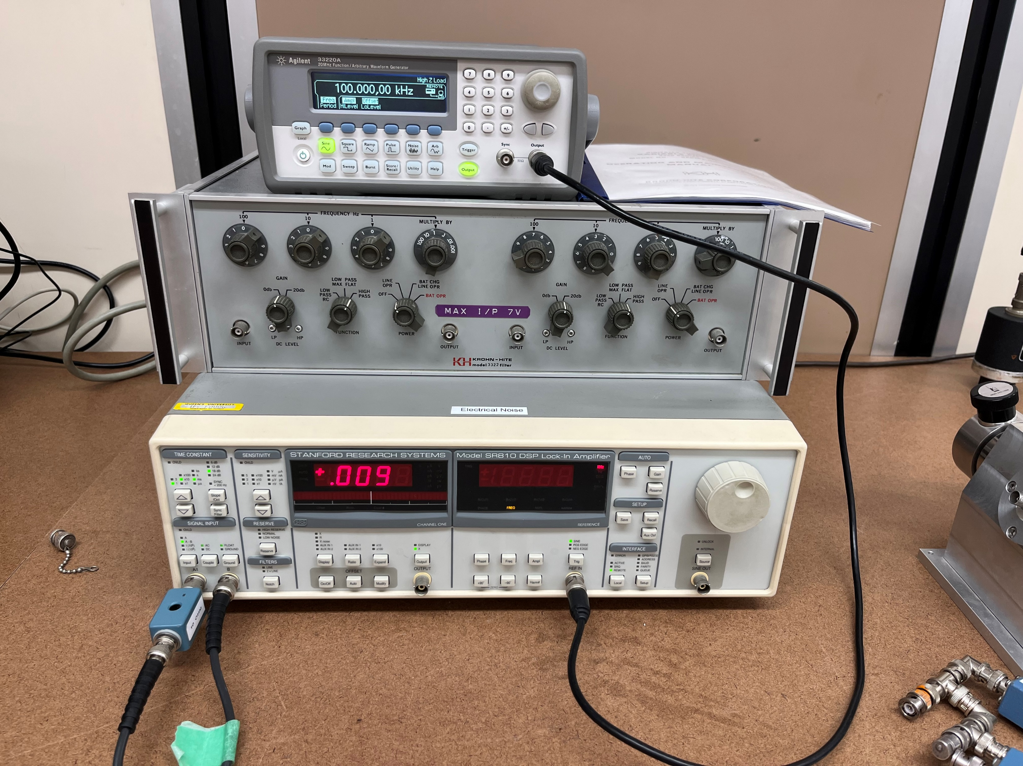
Function Generator
DSP Lock-In Amplifier
Resistor

